Slide 1

E-commerce Analytics Consultation
NAME: S.SAAI RAGAUVENDRA DATE: APR 2025
1

Slide 2
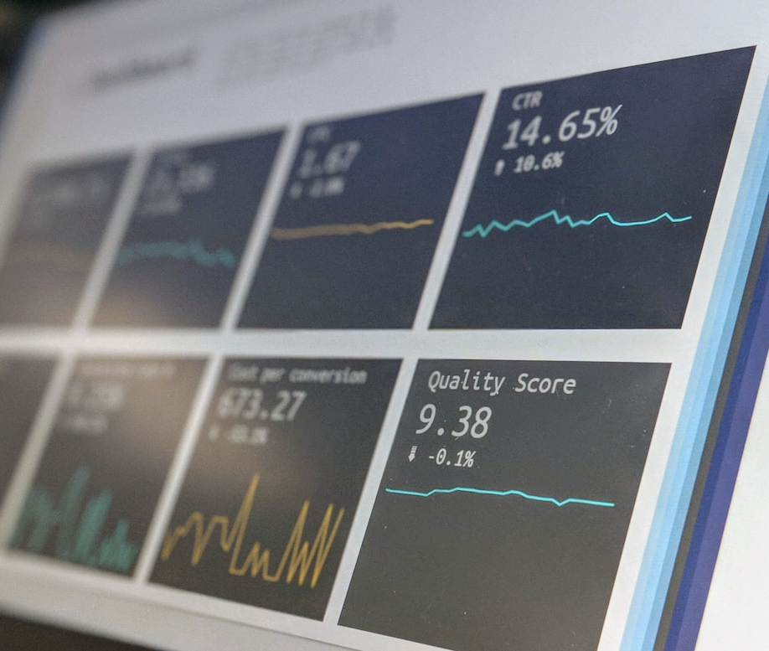
Real-Time Interaction Challenges
CORE CHALLENGES
Engaging participants in complex data-driven discussions is challenging, especially with intricate e-commerce topics. Non-technical attendees often struggle with technical details.
E-commerce Analytics Consultation
22
2

Slide 3

Let's Visualize Proposed Strategies and Recommended Tools for Ecommerce Analytics using some real-world scenarios
📈 1. Campaign ROI & Performance Tracking
🛒 Scenario: “Amazon Prime Day Campaign Analysis”
Problem Statement:
During Amazon Prime Day, the marketing team runs a multi-channel campaign: email blasts, social media ads, influencer partnerships, and push notifications. After the sale ends, the performance is not clear — the team wants to know which channel gave the highest return on investment (ROI).
Action Plan :
Use Channel Wise ad spend and revenue data.
Build a Dashboard using Excel/Power BI
like ROI = (Net Profit / Investment Cost)*100
Analyze the Customer Acquisition cost per channel
Recommend future budget allocation based on channel ROI
Outcome:
Marketing realizes Instagram Stories ads gave 2.8x ROI compared to email campaigns, so future spend is realigned.
So, they will shift more budget to Insta Stories in future!
E-commerce Analytics Consultation
4

Slide 4
Key Learnings
BOOSTING ENGAGEMENT
HANDS-ON PRACTICE
Future Enhancements
Active participation immerses candidates deeply; solving problems and sharing insights increases their engagement and aids comprehension.
Simulations bring analytics to life; candidates experience how insights translate into business results through real-time practice.
Incorporate hands-on sessions, live simulations, and gamified learning to keep participants engaged. Tools like BigQuery and Miro enhance interaction.
4

